Slide 1
Welcome to Himilcon’s lab for EDUC 275B (Data II)!
Lab 6
Thursday, February 29, 2024
Himilcon Inciarte
himilcon_Inciarte@berkeley.edu

Slide 2
Upcoming Assignments
Quiz 2:
02/25/2024
Homework 3 & 4:
02/26/2024
Project 1:
03/22/2024

Slide 3
Practice

Slide 4
Load faculty.dta (which you also need for today’s lab)
Regress salary only on assistant and associate professors and yearsdg.
For the questions below, be sure to use only the cases included in #1 above.
How many males are in the database?
Report the mean and standard deviation for yearsdg. Produce a scatterplot of its relationship with salary.
Show a box plot for salary within each value of gender.

Slide 5
Quiz 3

Slide 6
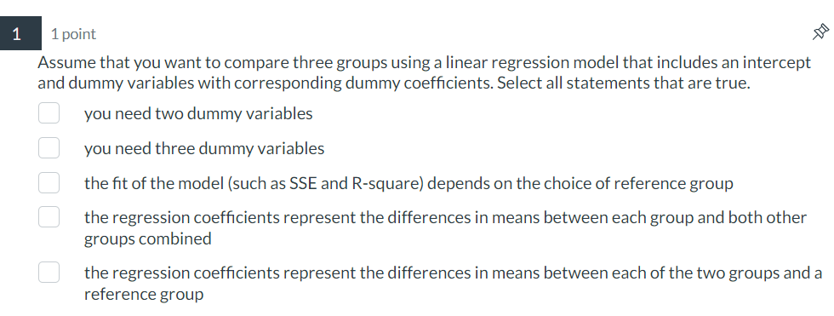

Slide 7
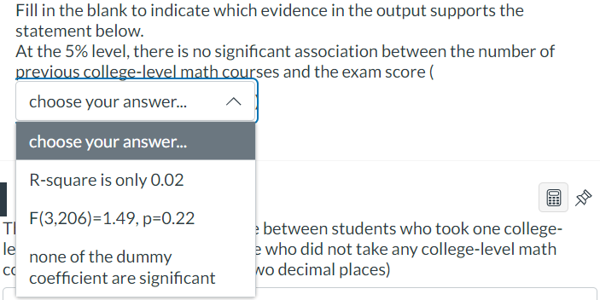

Slide 8
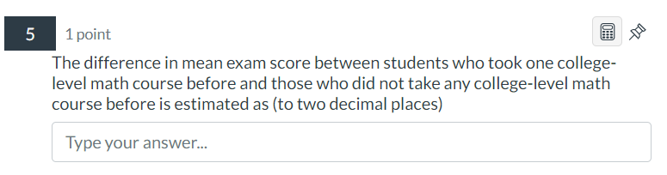

Slide 9
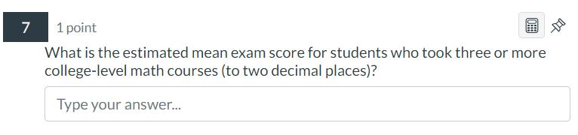

Slide 10
Lab 06.do

